Slide 1

Building better APIs

Slide 2

Who are we?

Slide 3
Everybody’s talking with apis
The number of APIs in every day applications is increasing
In my current apps we couple together half a dozen APIs from Sendgrid to Twilio to a bunch of APIs dealing with cars
We communicate with different groups inside the same company using APIs
Every one of them is terrible in its own special way

Slide 4
A cornucopia of design choices
Remote method invocation (Web Methods, CORBA, etc.)
Event Driven
REST
GraphQL
Notes:
There are a number of techniques you can use to build out APIs. Some of them are better for internal systems, and some for external system. Way back in the day we use to use remote method invocation….

Slide 5
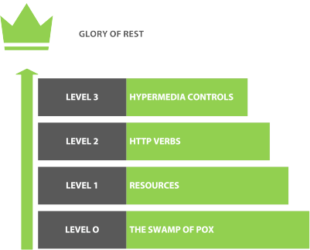
Rest Maturity
The Richardson Maturity Model describes 4 levels of building RESTful apis
Each level is harder to achieve
Notes:
Talk about each level

Slide 6

Building great APIs

Slide 7
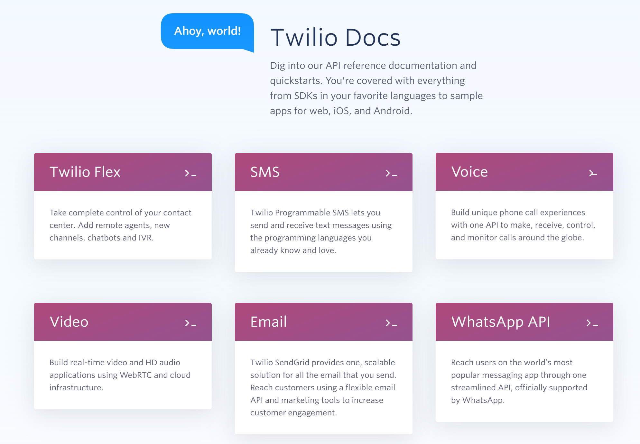
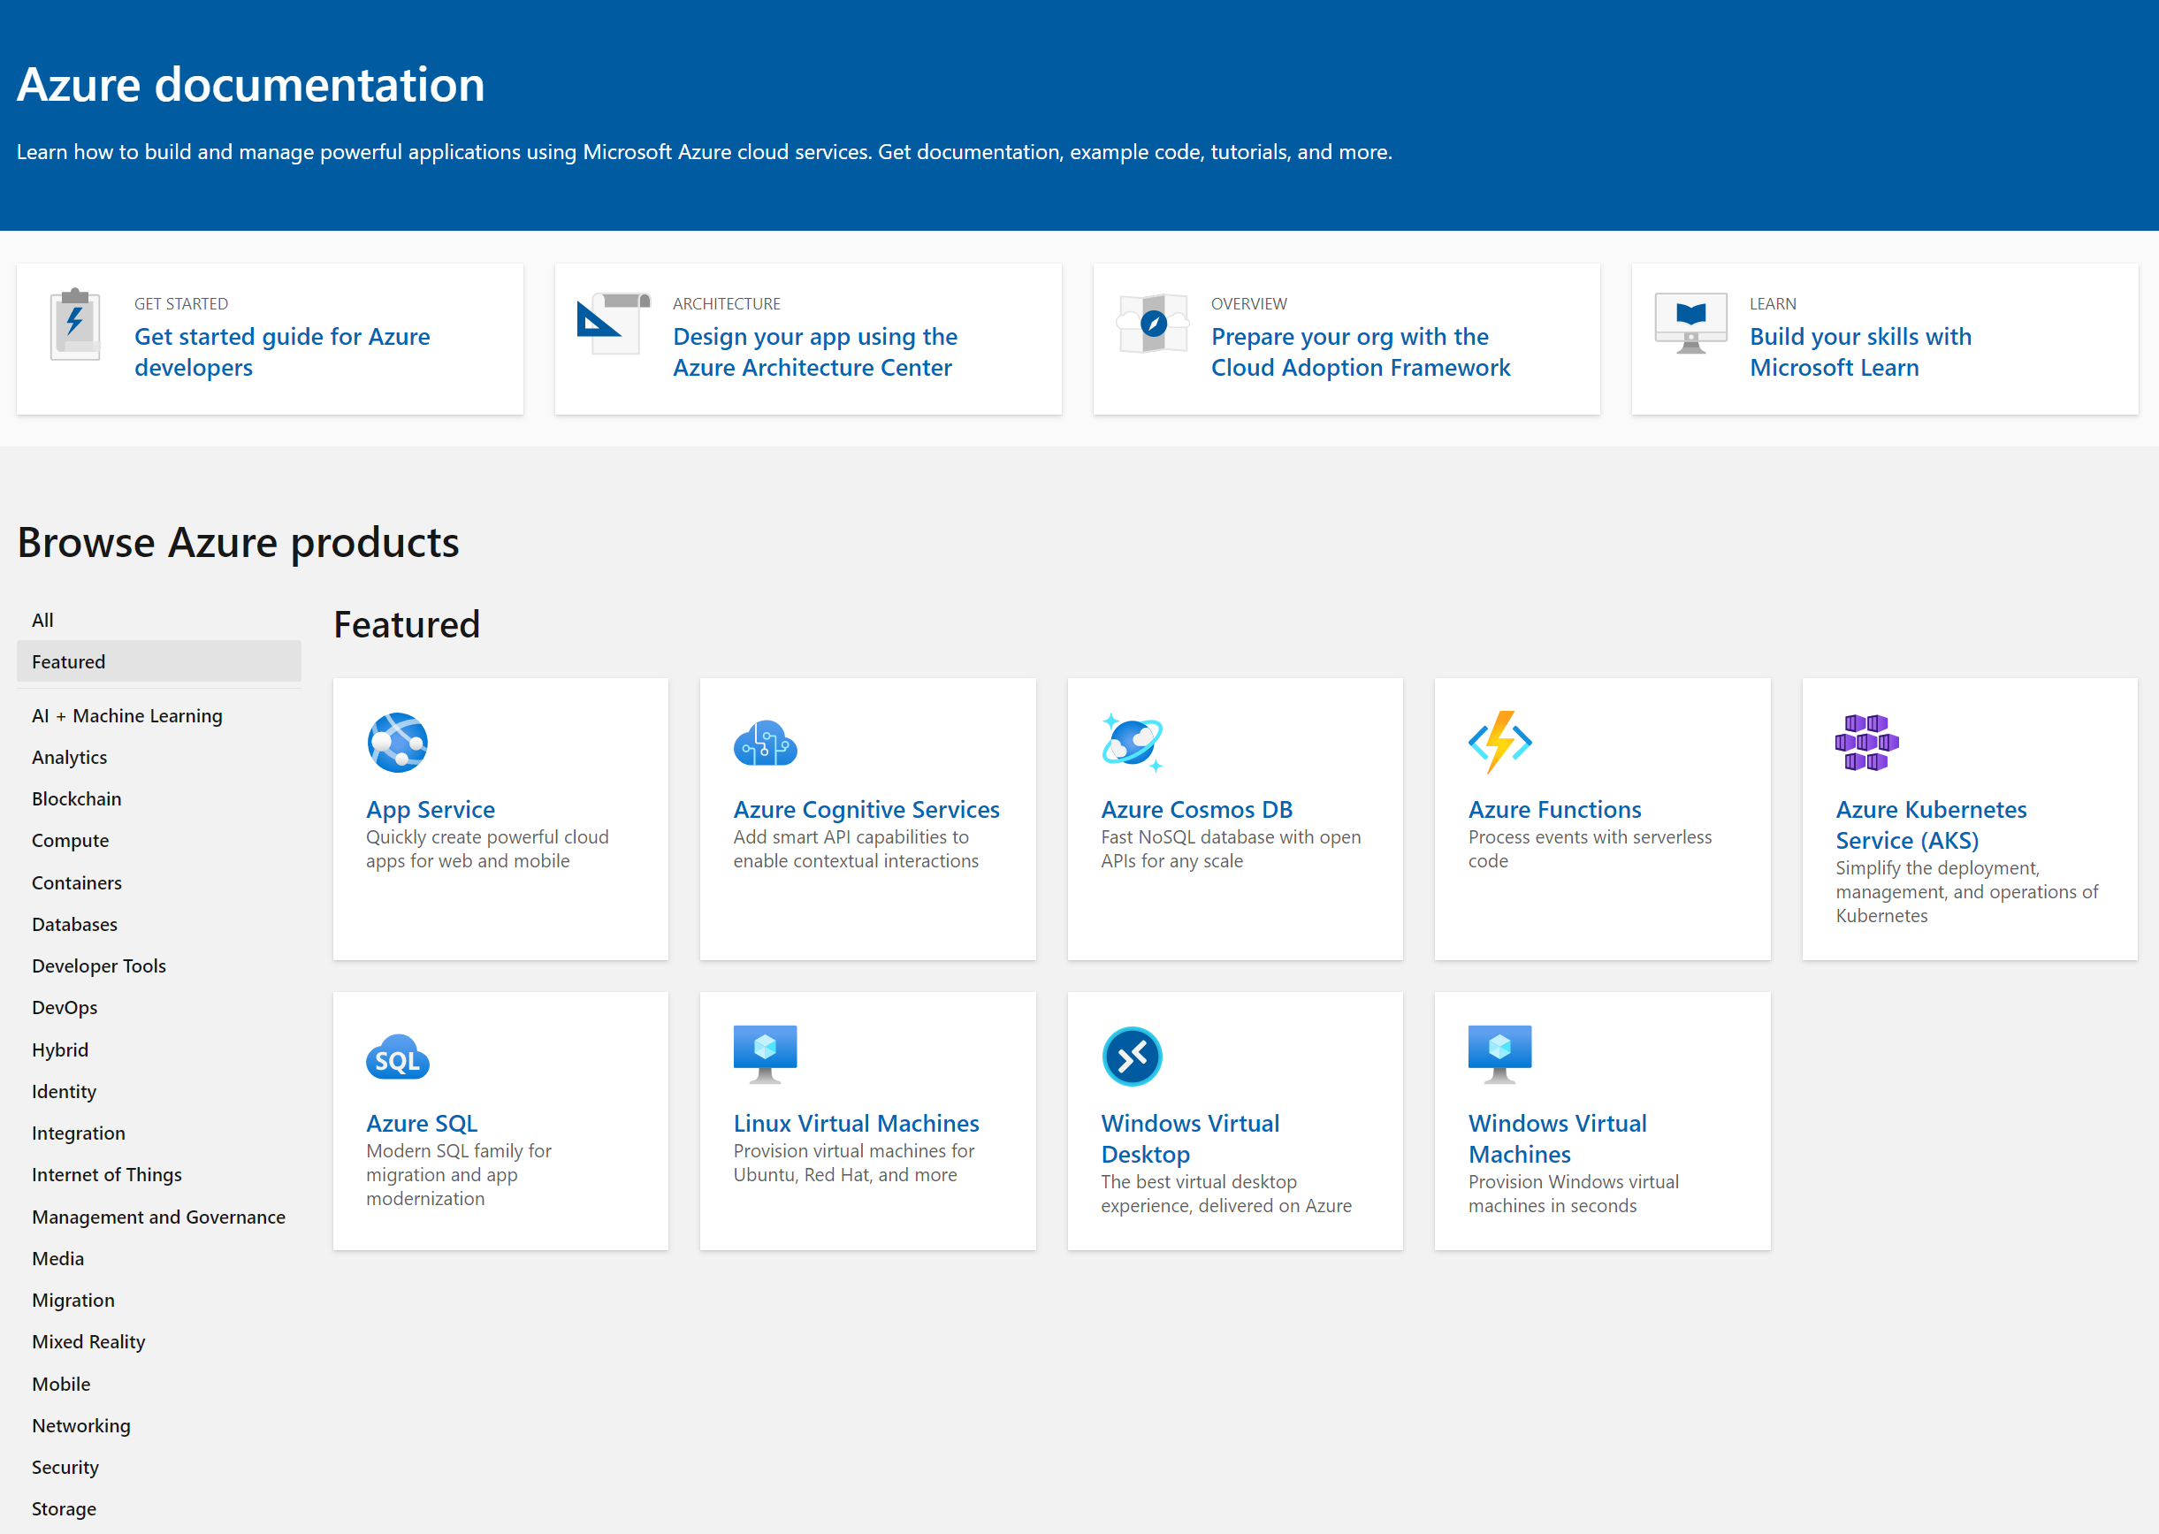
Start with amazing documentation
Notes:
If we want people to use our APIs and we do want that then the place to start is with good documentation. When I started programming Java was hot stuff and the docs for it were really good, considering it was 2000 and most people were still crawling out of the primordial ooze.

Slide 8
Swagger/open api
Notes:
The leading industry standard is a specification called open api. It was called swagger which I felt was a way better name. open api is a way of documenting your apis in a way that can be used both by humans and by computers.

Slide 9
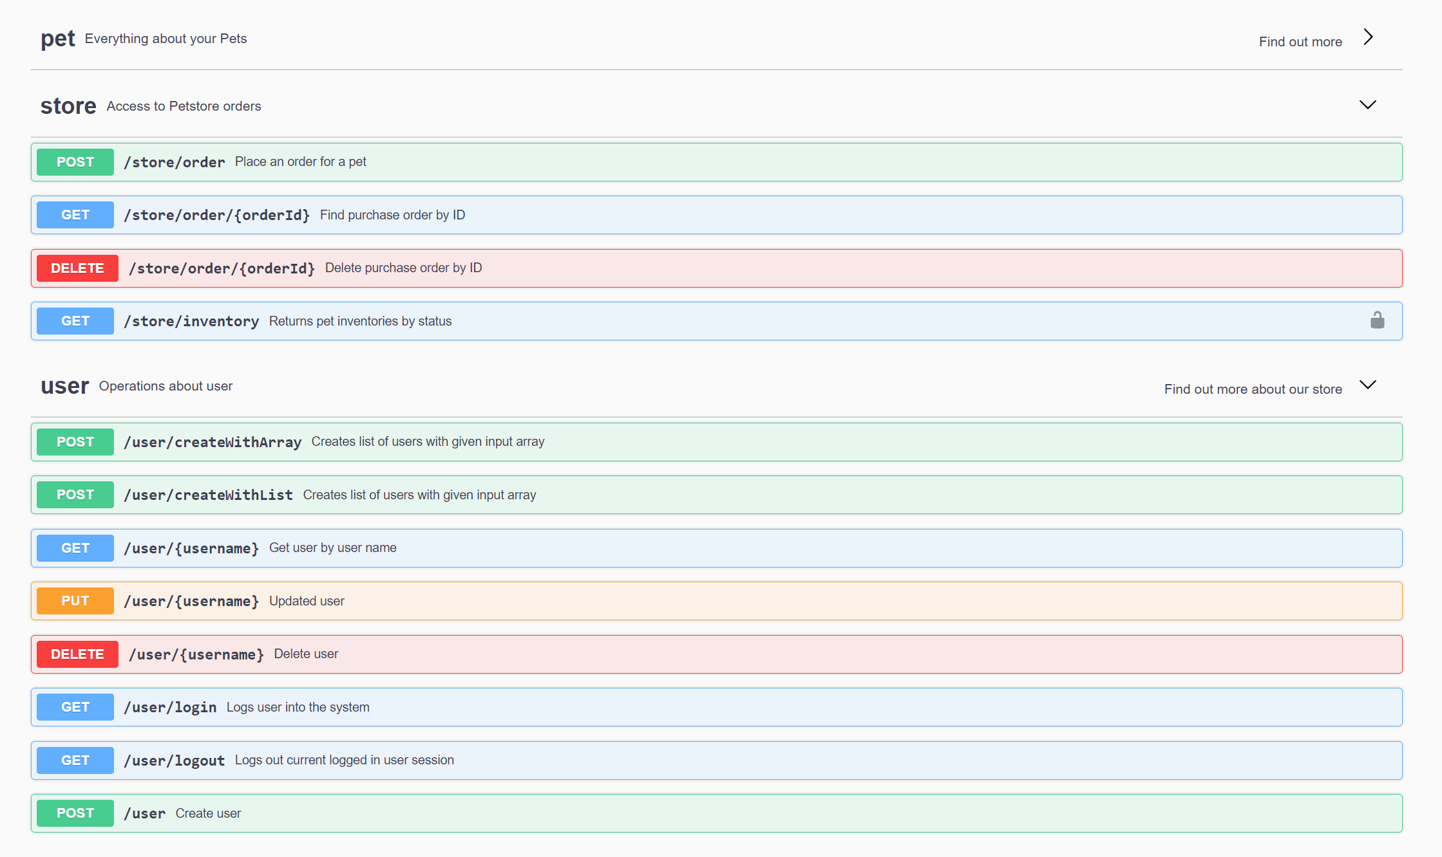
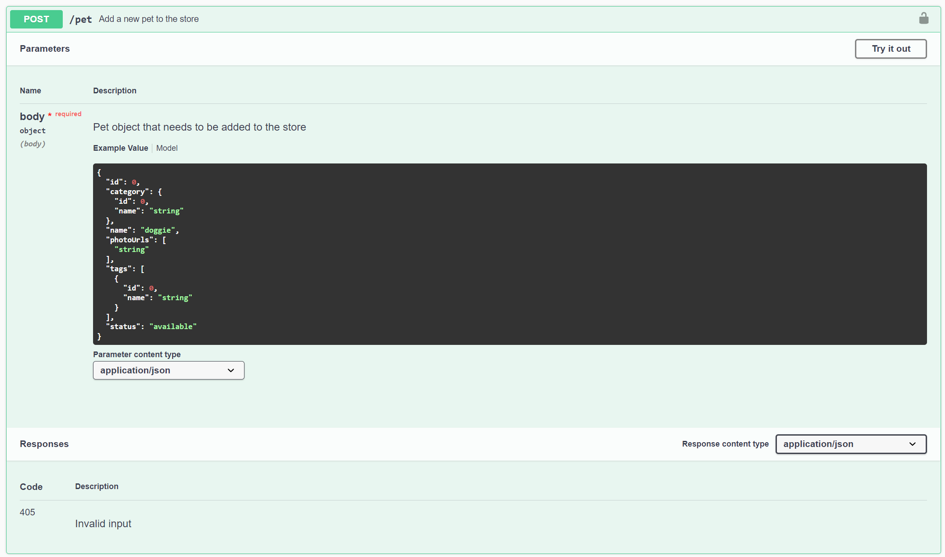
Swagger ui
Notes:
The swagger UI reads open api files and displays a handy visualization of each resource and the operations that you can perform on them

Slide 10
Swagger ui
Notes:
Drilling into one method we can see a sample body, the responses and parameters. You can even click on the try it out button to execute the api

Slide 11
Asp.net core has swagger
Demo
Notes:
Drop to visual studio and demo swagger

Slide 12
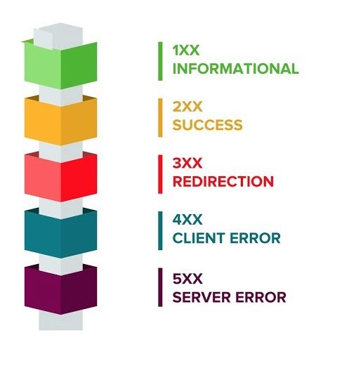
Status codes
As old as HTTP
Divided into several prefixes indicating the sort of result
Notes:
This is something I commonly see in APIs: incorrect use of status codes

Slide 13
Common, but incorrect, patterns
Return 200 for everything
Return 400 for every error
Return errors but without details

Slide 14
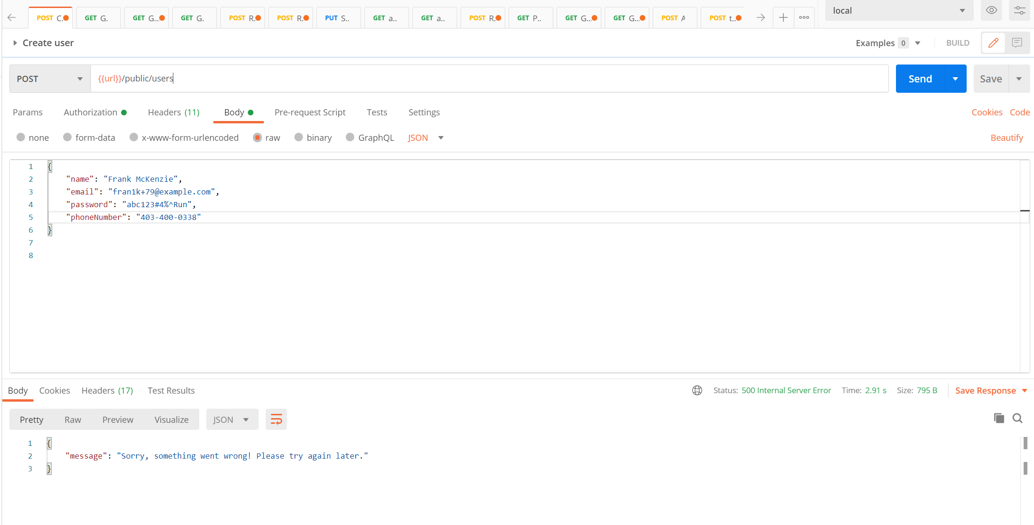
Return error messages inside of errors

Slide 15
Add details about the errors to swagger
Demo

Slide 16

Logging, logging, logging

Slide 17
Logging is
Instrumental in understanding the current state of production
Catching errors as quickly as possible
Looking of unusual usage patterns
Catching performance issues

Slide 18
Add Logging middleware
Demo
Notes:
Just right click it in

Slide 19
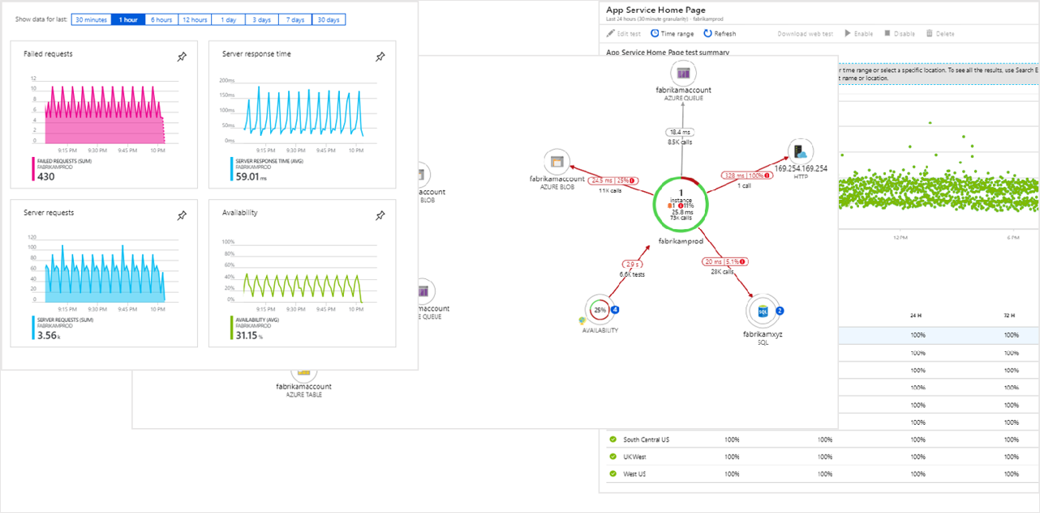
Gives you deep insights into your app
Notes:
Talk a little bit about some of the advantages of having logging in the application. Visibility into performance of requests, early warnings about errors, dig back in time and find when things went wrong. Answer questions like “did performance degrade with this release?” Mention the importance of log aggregation – correlating events from multiple sources, scaling out for multiple servers, gives you one place to go look for errors

Slide 20
Add application insights
Demo
Notes:
Just right click it in

Slide 21

Securing apis
Notes:
I’m not sure what this is a picture of but the caption said it is related to cyber security so who am I to argue?

Slide 22
Why do we need to secure?
Restricting access to private content
Understand who is calling the APIs
Provide different views of data to different groups
Make money on the API
Do rate limiting

Slide 23
Mechanisms for authenticating APIs
Preshared API key
OAUTH API authentication and bearer token
Notes:
Unlike a website we can’t provide an api with a popup asking for a user name and password. There are a few approaches for authenticating with APIs. The first is to use a preshared key. The second is to use OAUTH this uses another service to authenticate an api typically with a pair of keys and then pass a JWT or Bearer token to the api which then checks back with the OAUTH provider

Slide 24
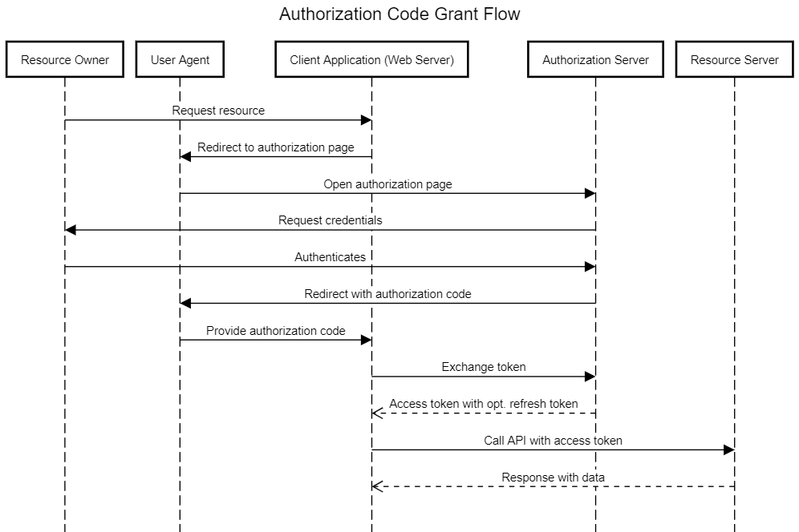
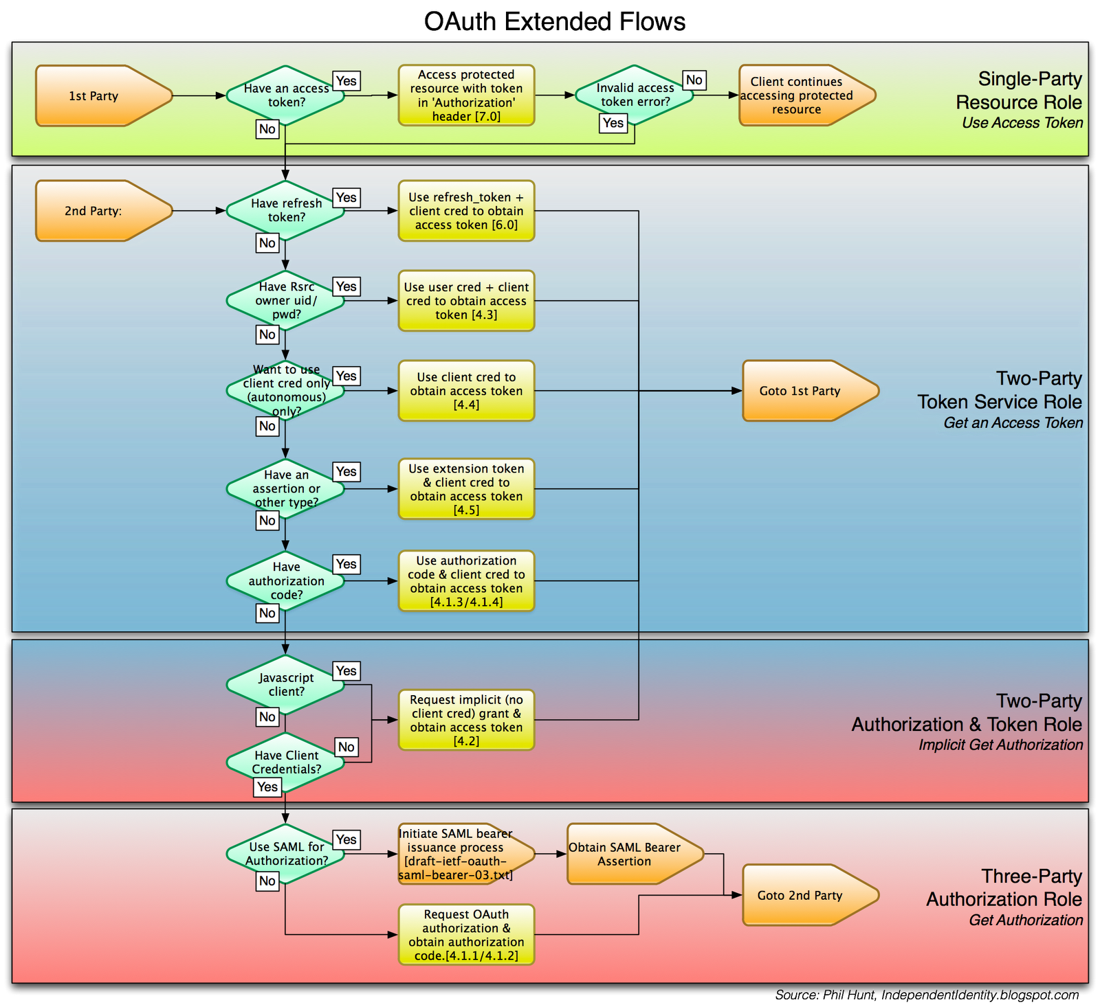
Oauth flows
Notes:
My biggest problem with OAUTH is that it is kind of complicated. If you search for diagrams of oauth you get things like these which look complicated. There are, however, some really good turorials now for it

Slide 25
Adding API keys
Demo
Notes:
Just right click it in

Slide 26

Encrypting transport

Slide 27
https always
There is no excuse to not use SSL/TLS
Notes:
Look, there just isn’t anymore. Years ago it was expensive but now it is free. Amazon and AWS both offer free certificates and if your outside of those two you can get certificates through Let’s Encrypt which even offer wildcard certificates now. Our problem was that http was unencrypted for years and, in general, nothing bad happened. But we want to switch the narrative

Slide 28
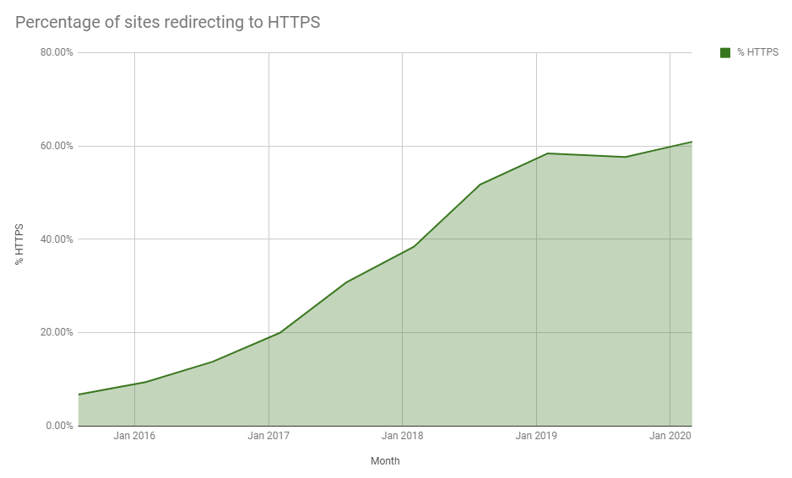
https adoption is growing

Slide 29
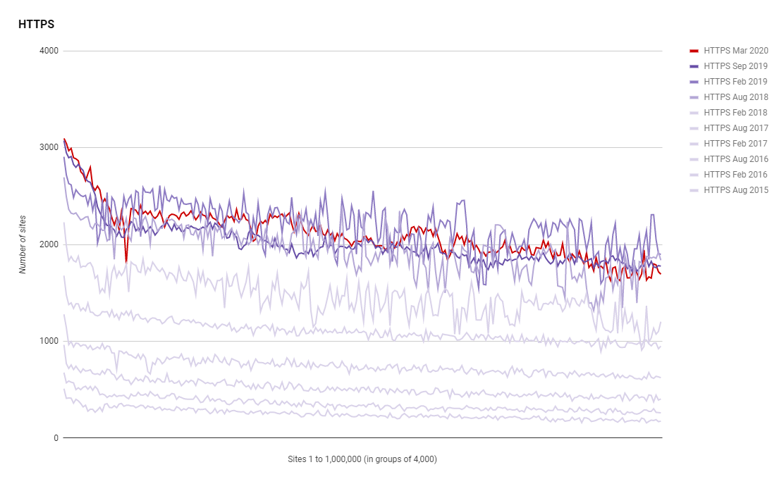
Every year the number of sites increases
Notes:
60.93% as of March this year

Slide 30
Adding SSL
Demo
Notes:
Just right click it in

Slide 31

Clarity of messages

Slide 32
Put thought into the content of your messages
Use numbers when the field is a number
Use consistently formatted dates
Include the name of units in your field names
Flatten your messages and avoid unnecessary wrappers

Slide 33
Enforcing api standards with analyzers
Demo
Notes:
Just right click it in

